Slide 1
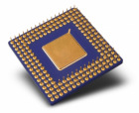
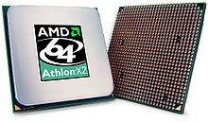
CHAPTER 7
Processor Structure and Function:
Central Processing Unit (CPU)

Slide 2
Topics
7.1) CPU Structure
7.2) Register Structure
7.3) Instruction Cycle

Slide 3
7.1) CPU Structure
Its function is to control the operation of the computer and performs its data processing functions.
CPU
Computer
Arithmetic
and
Logic Unit
I/O
Registers
System
Bus
CPU
Internal CPU
Interconnection
Memory
Control
Unit
Notes:
SSK3207

Slide 4
CPU
Early days – single CPU
Modern days – increasing use of multiple processors in a single computer
CPU 3 basic components:
  Control unit
  Arithmetic and logic unit (ALU)
  Registers
Arithmetic
and
Logic Unit
Registers
Internal CPU
Interconnection
Control
Unit
The Central Processing Unit (CPU)

Slide 5
Structure – the control unit
CPU
Arithmetic
and
Logic Unit
Registers
Internal CPU
Interconnection
Controls the movement of data and instructions into and out of the CPU and control the operation of the ALU and the computer as a whole.
Control
Unit
The Central Processing Unit (CPU)

Slide 6
Control Unit
Several approaches to the implementation of the control unit.
Most commonly used is microprogrammed implementation
Microprogrammed control unit operates by executing microinstructions that define the functionality of the control unit.
Figure shows the structure of control unit.
Sequencing
Logic
Control Unit
Registers and
Decoders
Control
Memory
Microprogram - a sequence of microinstruction
Microinstruction – an instruction that controls data flow and sequencing in a processer

Slide 7
Structure – the ALU
CPU
Performs computer data processing functions
Arithmetic
and
Logic Unit
Registers
Internal CPU
Interconnection
Control
Unit
The Central Processing Unit (CPU)

Slide 8
7.2) Register Structure
CPU
As a temporary storage in CPU
Also known as high speed memory
Its function is to temporarily hold data and instructions that are taken from other components (example MM, I/O U, cache etc) to be processed in the CPU.
Arithmetic
and
Login Unit
Registers
Internal CPU
Interconnection
Control
Unit
The Central Processing Unit (CPU)
Notes:
SSK3207

Slide 9
The registers in the processor perform 2 roles:
User-visible registers – enable the machine- or assembly language programmer to minimize main memory references by optimizing use of registers.
Control and status registers – used by the control unit to control the operation of the processor and by privileged, operating system program to control the execution of program.
(eg: PC, MAR, MBR and IR)

Slide 10
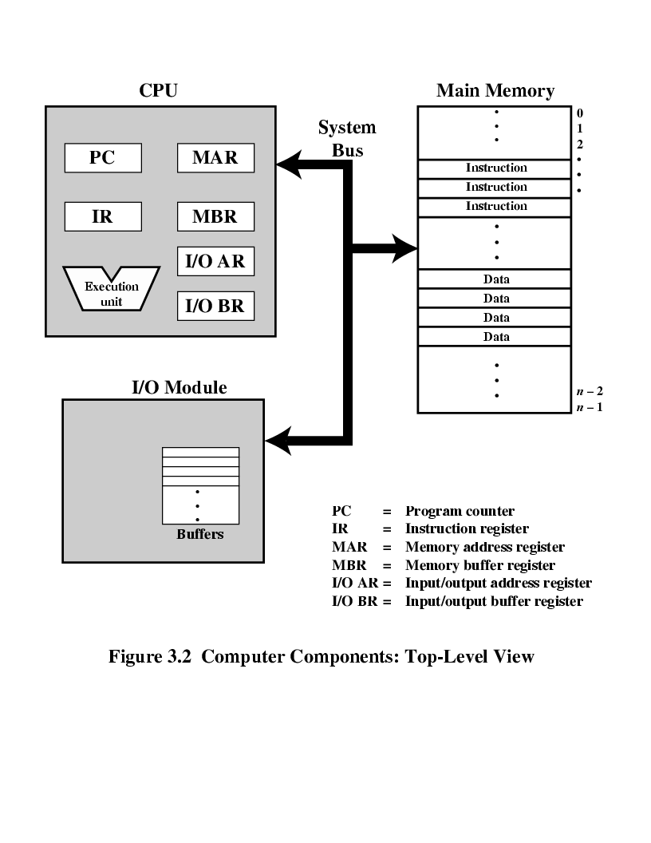
Figure illustrates top level view of computer components and suggests the interactions among them.
Computer Components: Top-Level View

Slide 11
7.3) Instruction Cycle
The function of computers is to execute programs.
Programs comprise a set of instructions and data that is stored in the main memory.
Every instruction will be taken and executed by the CPU one by one until all of them are executed.

Slide 12

Instruction Cycle (cont.)
The process of executing a single instruction is called Instruction Cycle which can be divided into:
1. Fetch Cycle
read the next instruction from MM into the CPU.
2. Execute Cycle
interpret the opcode and perform the indicated operation.
Operation code (to represent the operation)
Basic Instruction Cycle

Slide 13
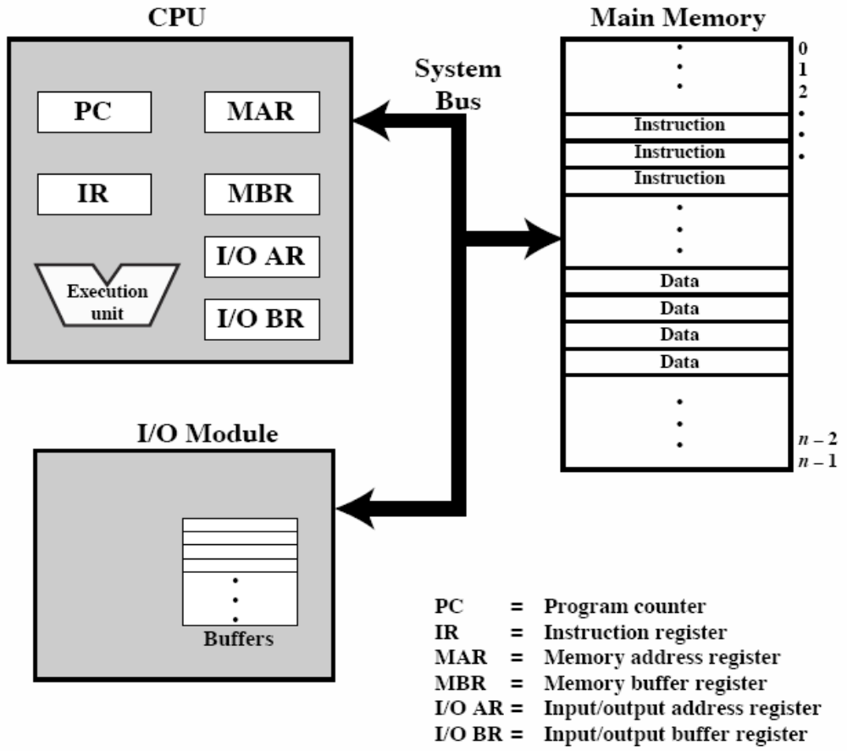
fetch
execute
fetch

Slide 14
Fetch Cycle
The process of fetching an instruction from MM into the CPU
4 registers are involved:
  i. PC (Program Counter)
- Temporary hold the address of an instruction (in MM) that
has to be fetched and executed in the CPU
ii. MAR (Memory Address Register)
- A register that connected to the MM through
the address bus.
- Temporary hold the address of an instruction from the PC.
- The content in PC will be transferred into the
MAR and then to the address bus and to the
location in MM that pointed by the address given.

Slide 15
iii. MBR (Memory Buffer Register)
- A register that connected to the MM through
the data bus
- Used to temporary hold instruction or data taken from
the MM or data that will be moved into the
MM or other computer components after
being processed by the CPU.
iv. IR (Instruction Register)
- Used to temporary hold instruction (operation code)
before it is being decoded by the Instruction
Decoder inside the control unit.

Slide 16
Generally the process in the Fetch Cycle can be depicted by:
MAR ← PC (specify address in MM for the next read/write)
MBR ← M (MAR) (data to be written/received from memory)
PC ← PC + 1 (hold address to be fetched next. CPU increment the PC after each instruction)
IR ← (MBR) (fetched instruction is loaded into register)

Slide 17
Address of the instruction
PC ←PC+1
Connected to MM
MAR ← PC
Address bus
Data bus
Hold instruction before it is decoded
IR ←(MBR)
Hold instruction/data taken from MM to be written to MM
MBR ← M(MAR)

Slide 18
Execute Cycle
The process of executing the instruction that has been fetched earlier in fetch cycle.
The followings are steps that are involve in execute cycle:
1. Instruction decoding (to determine the
operation that has to be performed by the CPU)
2. Operand (data) fetching
3. Data Processing
4. Store Result
The sequences of operations that happen in execution cycle differ according to the type of instruction.

Slide 19
2
1
ALU
X
(Data)
3
(Data)
R1
MM
CPU
Example: ADD R1, X
This instruction adds the content in the R1 register with the content in the MM at location X and the result is stored in the R1 register, i.e.: R1 ← R1 + M (X)
(Observe the diagram above)

Slide 20
Before the addition operation is performed in the ALU, the required data is taken and moved into a register in the CPU
The data in R1 is already in the CPU (R1 is one of the registers in CPU)
The addition operation is performed in ALU and the result is stored in the R1 register
The process which takes place in the Execution Cycle for instruction ADD R1,X can be depicted by:
  MAR ← IR (address X)
  MBR ← M (MAR)
  R1 ← R1 + MBR

Slide 21
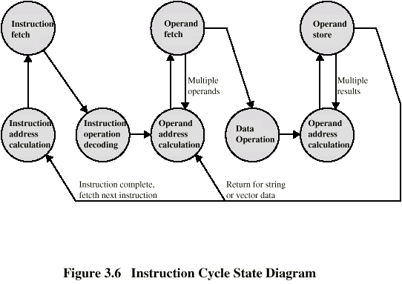
Instruction Cycle State Diagram
A more detailed look at the basic instruction cycle.
The figure is in the form of a state diagram.
For any given instruction cycle, some states may be null and others may be visited more than once.

Slide 22
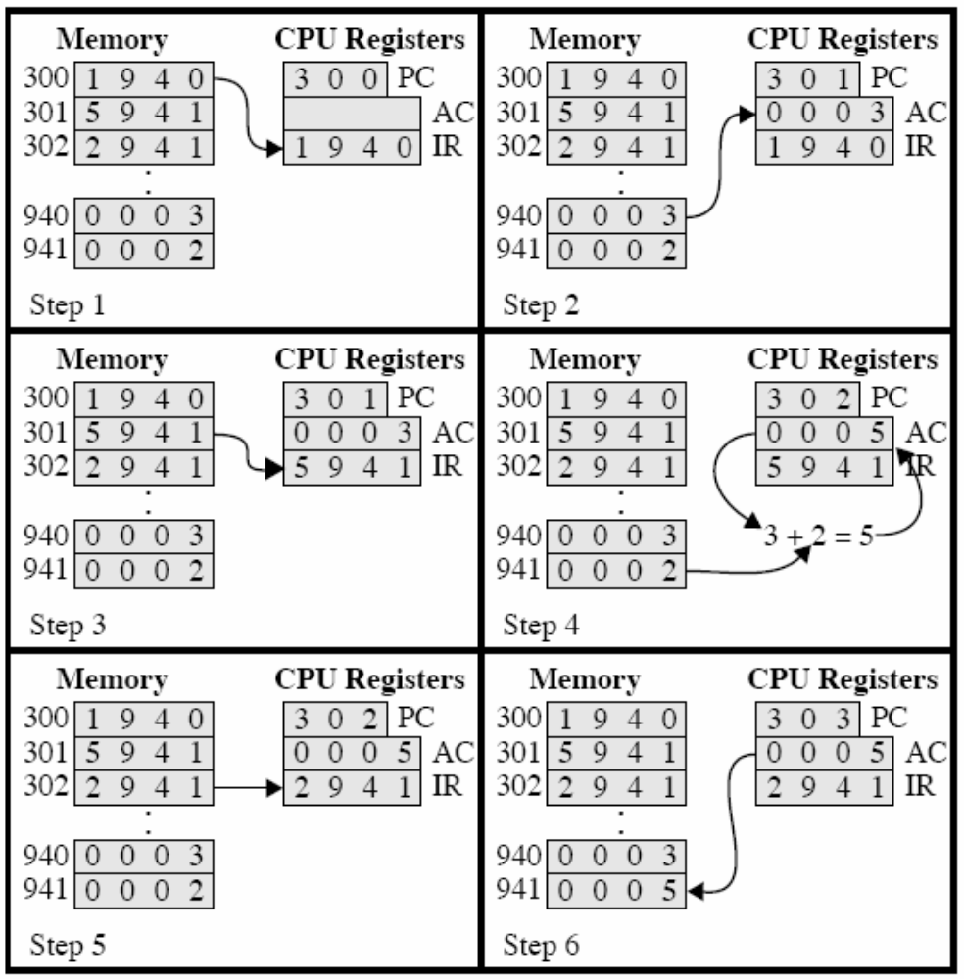
Example of Program Execution
Increment (next instruction)
Load data from address 940
A single register
MAR MBR
Load data to Accumulator (AC)
Add with the contents of 941
Add
Store in 941
store

Slide 23
Exercise
Main Memory
0001 Load AC from I/O device 5
0010 Add contents in AC with data from address 940
0011 Store AC to I/O device 6
0100 …
.
.
.
940 2
I/O Module
device 5 device 6
3
.
.
.

